Slide 1
Court and Crime
If you can’t do the time don’t do the crime!
What do you think should happen and does it agree with what the real decision was.

Slide 2
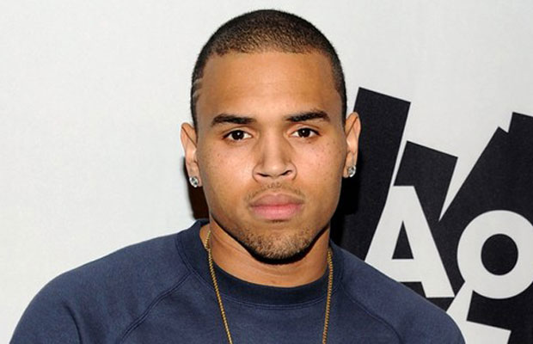
Chris Brown
Born May 5, 1989
American R&B artist
Crime: 2009 Felony Assault on then-girlfriend
Singer Rhianna and Felony making Criminal
Threats.
Which court would he go to?
What do you think would be an appropriate punishment?

Slide 3
Chris Brown
He would go to the Superior Court of NC for Felony Charges
What really happened:
He was ordered to rehab and warned if he lost his temper again he would be in jail.
His original jail time would be at best 3-6 months at worst over 3 years in prison.
Now he is about to go to trial again for anger management after losing his temper AGAIN while IN rehab AGAIN.

Slide 4
Lindsay Lohan
Born: July 2, 1986
American Actress and Singer
2007 – Misdemeanor charge of
Driving under the Influence (AKA DWI in this state).
Has been in and out of rehab twice.
Which court would she go to?
What do you think would be an appropriate punishment?

Slide 5
Lindsay Lohan
For her Misdemeanor Charge she would stay at State District Court.
Lindsay Lohan was also charged with a felony drug procession of cocaine and drug transport at this time (this would send her to Federal District Court).
She was sent to rehab for the third time and his sentenced to probation.
She spends the next several years in and out of the court room (along with jail and rehab) for missing court dates, DUI, drugs, and maybe hitting someone in the face…

Slide 6
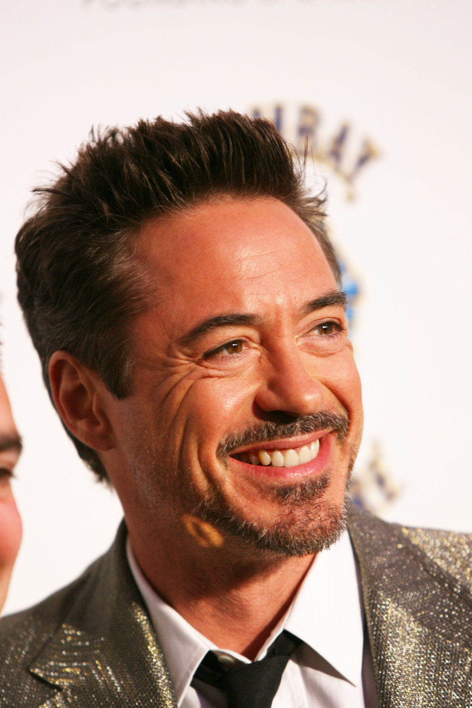
Robert Downey Jr
Born: April 4, 1965
American Actor
Felony charge of drug procession in the early 1990s of Cocaine,
Heroine, and Crack.
He has been addicted to drugs as early as 8 years old.
Was pulled over and found with drugs and under the influence
Which court would he go to?
What do you think would be an appropriate punishment?

Slide 7
Robert Downey Jr.
What Happened:
This charge would send him to Federal District Court because of dealings with the DEA and for the felony charges of Cocaine, Heroine, and Crack.
He went into Rehab and his last drug incident was in the 2003 and he has since then remained clean and out of jail (with the exception of a slight misunderstanding and out of date information when the Iron Man cast and crew were in Japan for a premiere).
He did spend some time in jail between 1996 – 2001 for various felony charges involving drugs of Cocaine, Heroine, and Crack when it was realized that rehab wasn’t working. Downey himself stated that prison was the best eye-opener to help end his addiction.

Slide 8
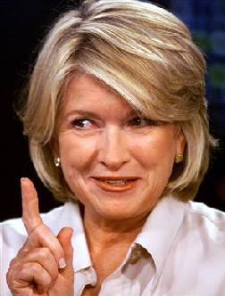
Martha Stewart
Born: August 3, 1941
American Businesswoman, deals in stocks, TV personnel
Felony charges of obstruction of justice,
lying to investigators, and insider trading.
Which court would she go to?
What do you think would be an appropriate punishment?

Slide 9
Martha Stewart
What Happened:
This would go to a Federal District Court for the insider trading.
She was sentenced to 5 months of prison time and then 5 months of house arrest.
She has since remained clean and pulled her business back together.

Slide 10
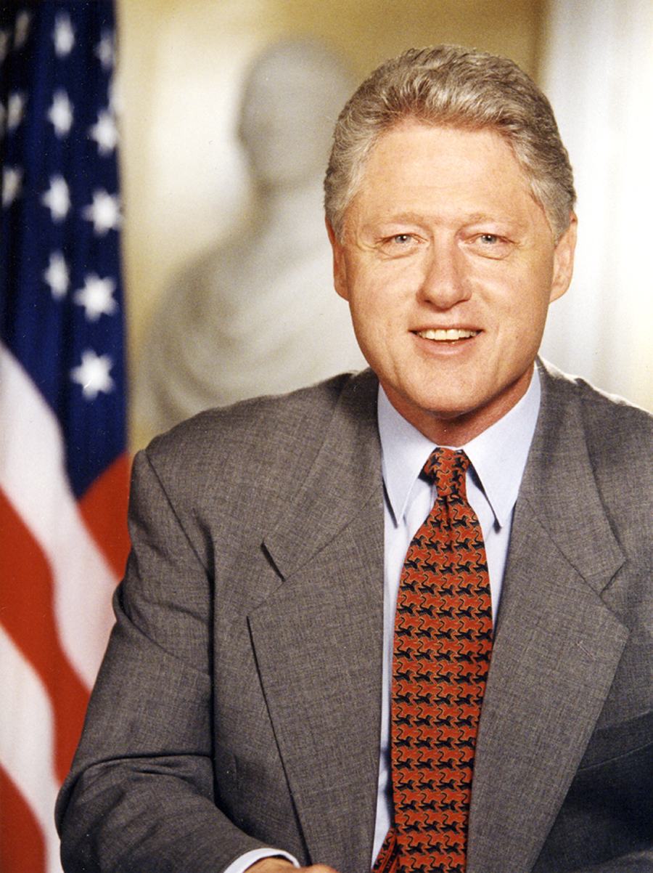
Bill Clinton
Born: August 19, 1967
American Politician
Charged with lying under oath and obstruction of justice
about his affair with Monica Lewinsky while President and Jones
Civil Court case.
Which court would he go to?
What do you think would be an appropriate punishment?

Slide 11
Bill Clinton
What happened:
He was formally charged in front of Congress in 1998 (he was still in office), but without a clear majority from the senate he was cleared of his charges.
He is still impeached though, but allowed to stay in office until 2001.
He has since then kept him image clean and remained active in politics especially in the last election.

Slide 12
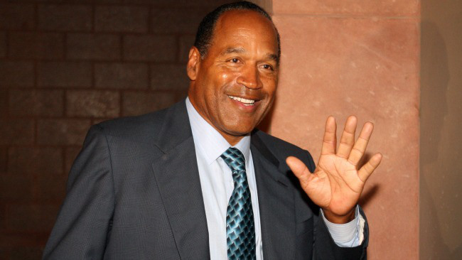
OJ Simpson
Born: July 9, 1947
American Athlete
OJ Simpson was charged in 2008 with several
charges the biggest being a felony charge of
kidnapping and a felony charge of robbery.
Which court would he go to?
What do you think would be an appropriate punishment?

Slide 13
OJ Simpson
What happened:
These charges would send OJ to the NC Superior Court.
He was charged with murder in the early 1990s, but was acquitted.
With these recent charges he was given jail time for 30 years (the difficulty was trying to separate old wounds with the previous murder charge).
He has also been granted parole recently, but still has some jail time to fulfill first.

Slide 14
DMX
Born: December 18, 1970
American Rapper
Was charged in 2013 for driving with a
suspended license.
Which court would he go to?
What do you think would be an appropriate punishment?

Slide 15
DMX
He would go to State District Court for this crime.
He paid bail and will have a minor punishment (it won’t affect his touring).
He has had many run-ins with the police for more serious crimes and have even served jail time in Arizona.
Currently, I hope he is not driving, but he seems to just be continuing his music career. In the last months he has not been in trouble.

Slide 16
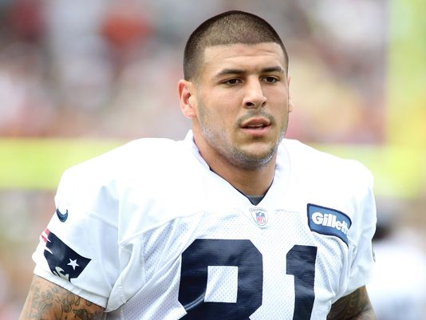
Aaron Hernandez
Born: November 6, 1989
American Athlete
Charged in 2013 for a murder and gun charges.
It seems to be gang related.
Which court would he go to?
What do you think would be an appropriate punishment?

Slide 17
Aaron Hernandez
What happened:
This would be a case for the Superior Court.
He has had minor run-ins before, but nothing that has led to any real trouble nor slowed his rising football career.
He has not been found guilty or not-guilty yet, but has been denied bail.

Slide 18
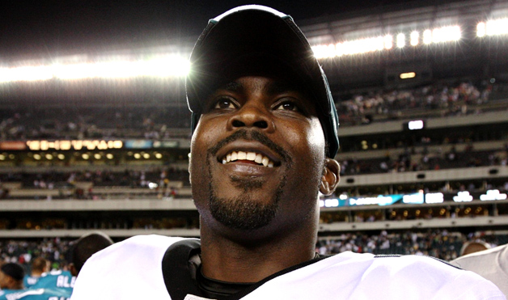
Michael Vick
Born: June 26, 1980
American Athlete
Was charged with several counts of felony
Dog fighting and animal torture.
Which court would he go to?
What do you think would be an appropriate punishment?

Slide 19
Michael Vick
What happened:
This case went before the Federal District Court, because he file pleas with them. Typically, cases like this would deal with Superior Court.
He spent 23 months in prison.
Was forced to declare bankruptcy, but has since kept a very clean image and resumed his football career.

